Slide 1
Confirmatory Factor Analysis (CFA)

Slide 2
Understanding Factor Analysis

Slide 3
What is Factor Analysis ?
A statistical technique comprised of two steps: EFA and CFA
Explains the variance and covariance between observed variables and unobserved factors
Explains how underlying factors are responsible for variance
Measures how weighting of each unobserved factor is different
LV1
LV2
OV1
OV2
OV3
OV4

Slide 4
Confirmatory Factor Analysis

Slide 5
Key Terminology
Reliability Estimation: The percentage of variability in observed variables that is reliable
Factor Loading: Coefficient indicating the strength of the relationship between observed and latent variables
Observed Variables: Variables that are actually measured, can also be referred to as indicators
Latent Variables: Theoretical constructs, cannot be directly observed. They are inferred from the observed variables. Can be psychological traits

Slide 6
What is Confirmatory Factor Analysis ?
A latent variable method that tests if data fits a hypothesized model
Used after Exploratory Factor Analysis (EFA)
Validates structure of relationship between observed and latent variables
LV1
LV2
OV1
OV2
OV3
OV4
e
e
e
e
Notes:
Covariance shows the extent to which the latent variables are related

Slide 7
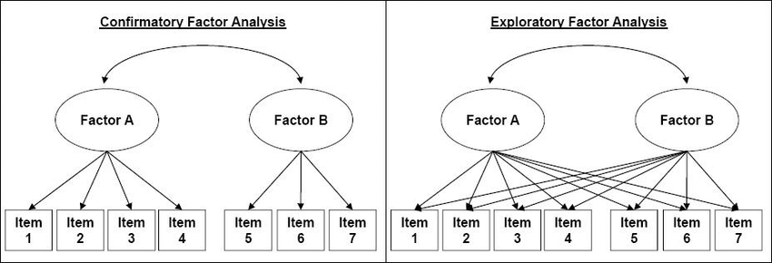
CFA vs EFA
Notes:
· Hypothesis first created through exploratory factor analysis (EFA)
· If the model has been formulated, with a clear hypothesis, we move on to confirmatory factor analysis
· Tests the validity of a latent variable model
· Each factor affects its own variables

Slide 8
How is CFA done?

Slide 9
Core Model
Defines direct relationship between latent and observed variables
Shows which observed variables are affected by which latent variable
x=Λξ+δ
X = Vector of observed variables
Λ = Factor loading matrix
ξ = Vector of latent variables
δ = Residuals

Slide 10
Building a CFA Model

Slide 11
Six Stages:
Stage 1: Objectives
Define Research Question
Identify Latent Variables
Stage 2: Design
Select Indicators: These are the observed variables which are hypothesized to be affected by latent variables
Preprocessing: Missing values, outliers, imputation.
Overfitting: Cross Validation
Sample Size: n > 200 to ensure reliability
Stage 3: Assumptions
Multivariate normality: Indicators should be multivariate normally distributed.
Random Sampling: Data must be collected from random samples to generalize findings
Linearity: Relationships between observed and latent variables is linear
Notes:
1. Defining Constructs: The process begins by clearly defining the theoretical constructs. In this stage, researchers often pretest the construct’s items to evaluate their clarity and ensure they accurately represent the concept.
3. Specifying the Model: Researchers must specify the number of factors and the pattern of loadings (which variables load on which factors). This specification is based on theoretical expectations or results from previous studies.

Slide 12
Six Stages:
Stage 4: Model Estimation
Parameters include: factor loading, error variance and factor variances and covariance
Use estimation models such as: Maximum likelihood, Generalized Least Squares
Stage 5: Interpretation
Factor loading > 0.5
Residuals to identify areas of low fit
Chi-square: Non-significance suggests good fit. Compares observed and expected covariance matrices
Comparative Fit index > 0.95
RMSEA < 0.06
SRMR < 0.08
Stage 6: Validation
Cross validation.
Measurement Invariance: Check if model works across different groups (gender, age)
Notes:
Chi-squared → Assess whether the model fits the data
Comparative Fit Index → Compares the local model to a baseline model → Less sensitive to sample size than Chi-squared
Root Mean Square Error of Approximation → How well it fits population covariance matrix. Penalizes model complexity and helps avoid overfitting, does not work well on small or simple models
Standardized Root Mean Square Residual → Average difference between observed and model correlations. Should be used in combination with another measure
4. Assessing Model Fit: The validity of the measurement model is assessed by comparing the theoretical model with the actual data. This includes examining factor loadings (with a standard threshold of 0.7 or higher for adequate loadings), and fit indices such as Chi-square, Root Mean Square Error of Approximation (RMSEA), Goodness of Fit Index (GFI), and Comparative Fit Index (CFI).

